Slide 1
HTML
T-level

Slide 2
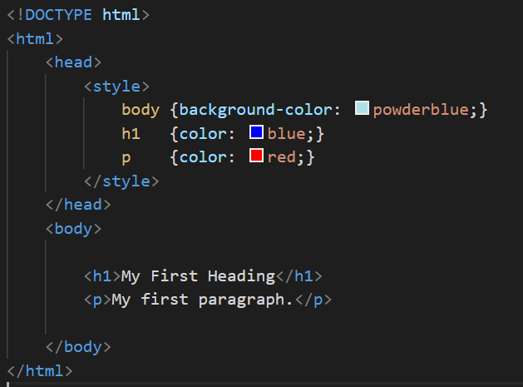
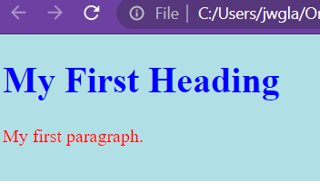

Slide 3

TAG attributes
Missing image

Slide 4

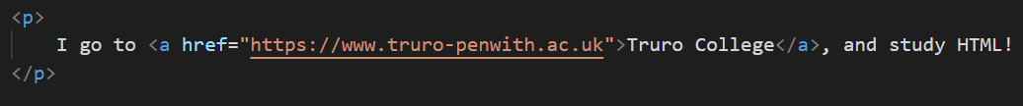
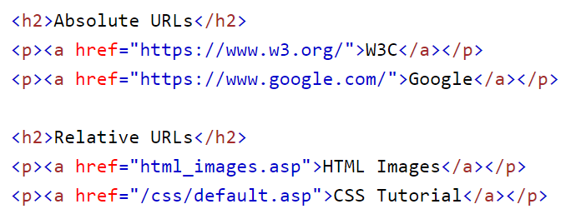
Anchor tags

Slide 5
You should have completed:
Create a new folder called “anchors”
Using the template you have created
Copy it THREE times into the folder “anchors”
index.html
contact.html
me.html

Slide 6
Today - lists
Unordered
Ordered
Nested

Slide 7
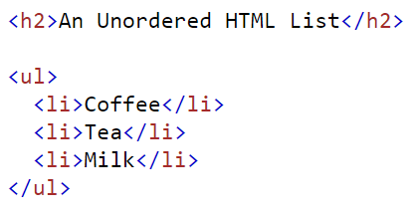
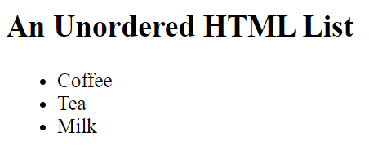
Task:
Copy template.html
Name it -> unordered-list.html

Slide 8
New list:
Add an unordered list into it --- your top 5 games or books

Slide 9
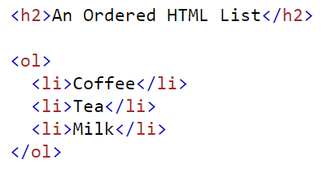
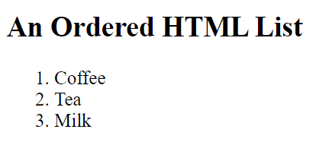
Task:
Copy template.html
Name it -> ordered-list.html

Slide 10
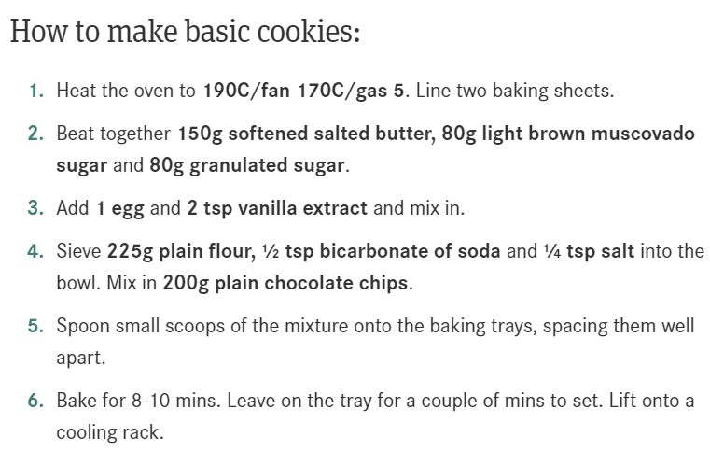
New list
Add an ordered list into it ---- a cookie recipe
Bold

Slide 11
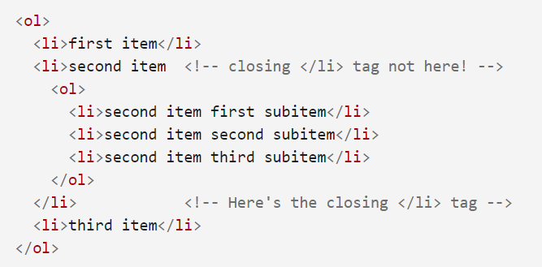
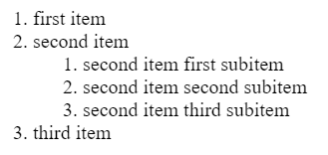
Task:
Copy template.html
Name it -> ordered-list.html
Add an ordered list into it ---- a cookie recipe

Slide 12
EXIT QUIZ
What are the following tags:
<a>
<ol>
<li>
<ul>
<p>
<head>
<body>
<html>

